Slide 1
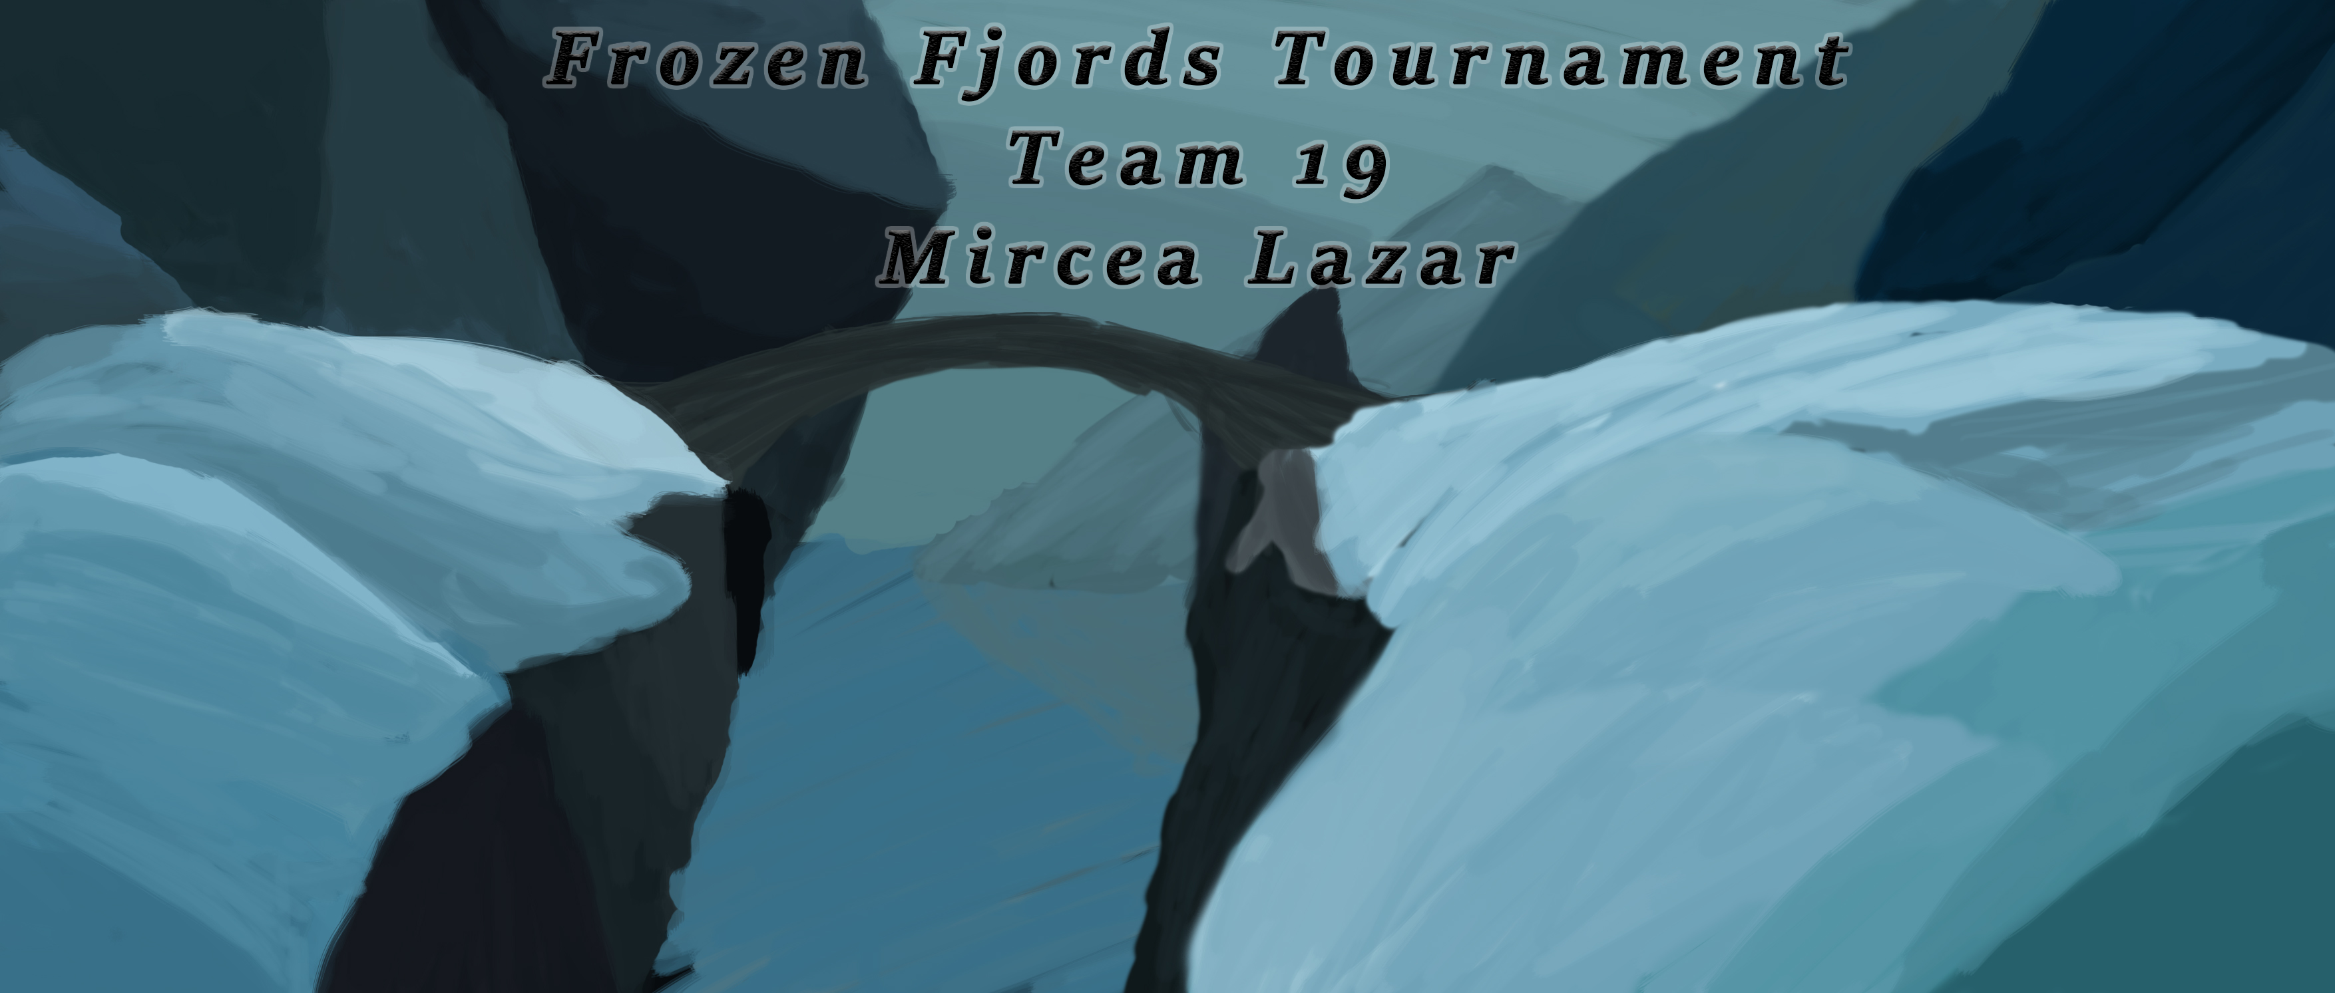

Slide 2
Meaningful choice
Twitch mechanic
Balancing
Aestetichs
Emotions

Slide 3
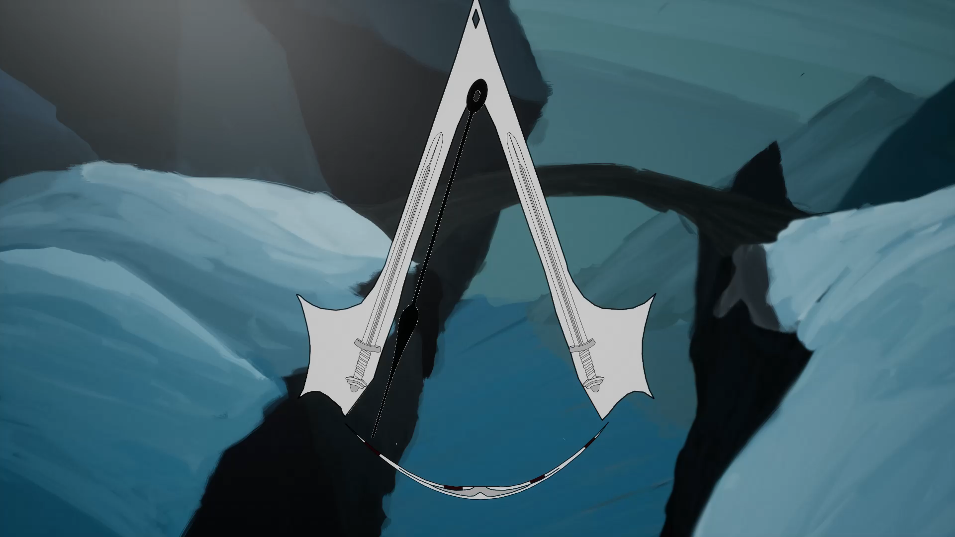

Slide 4
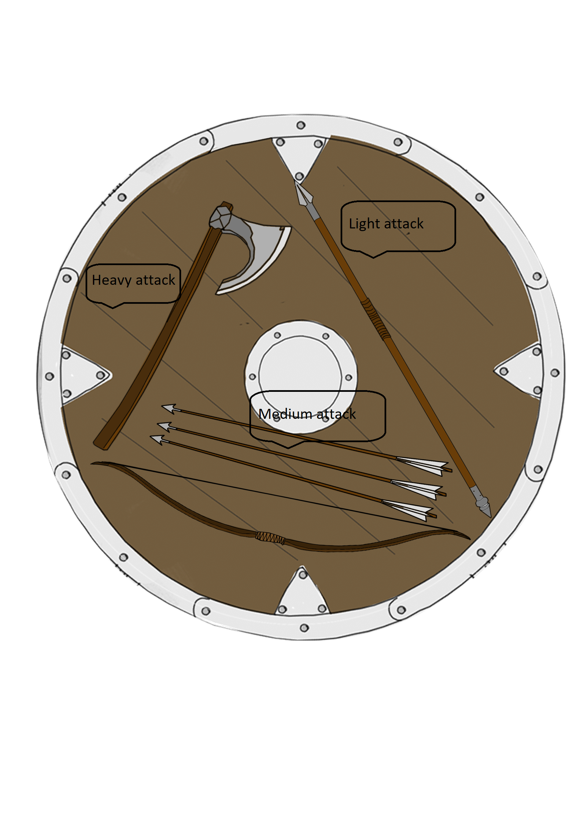

Slide 5
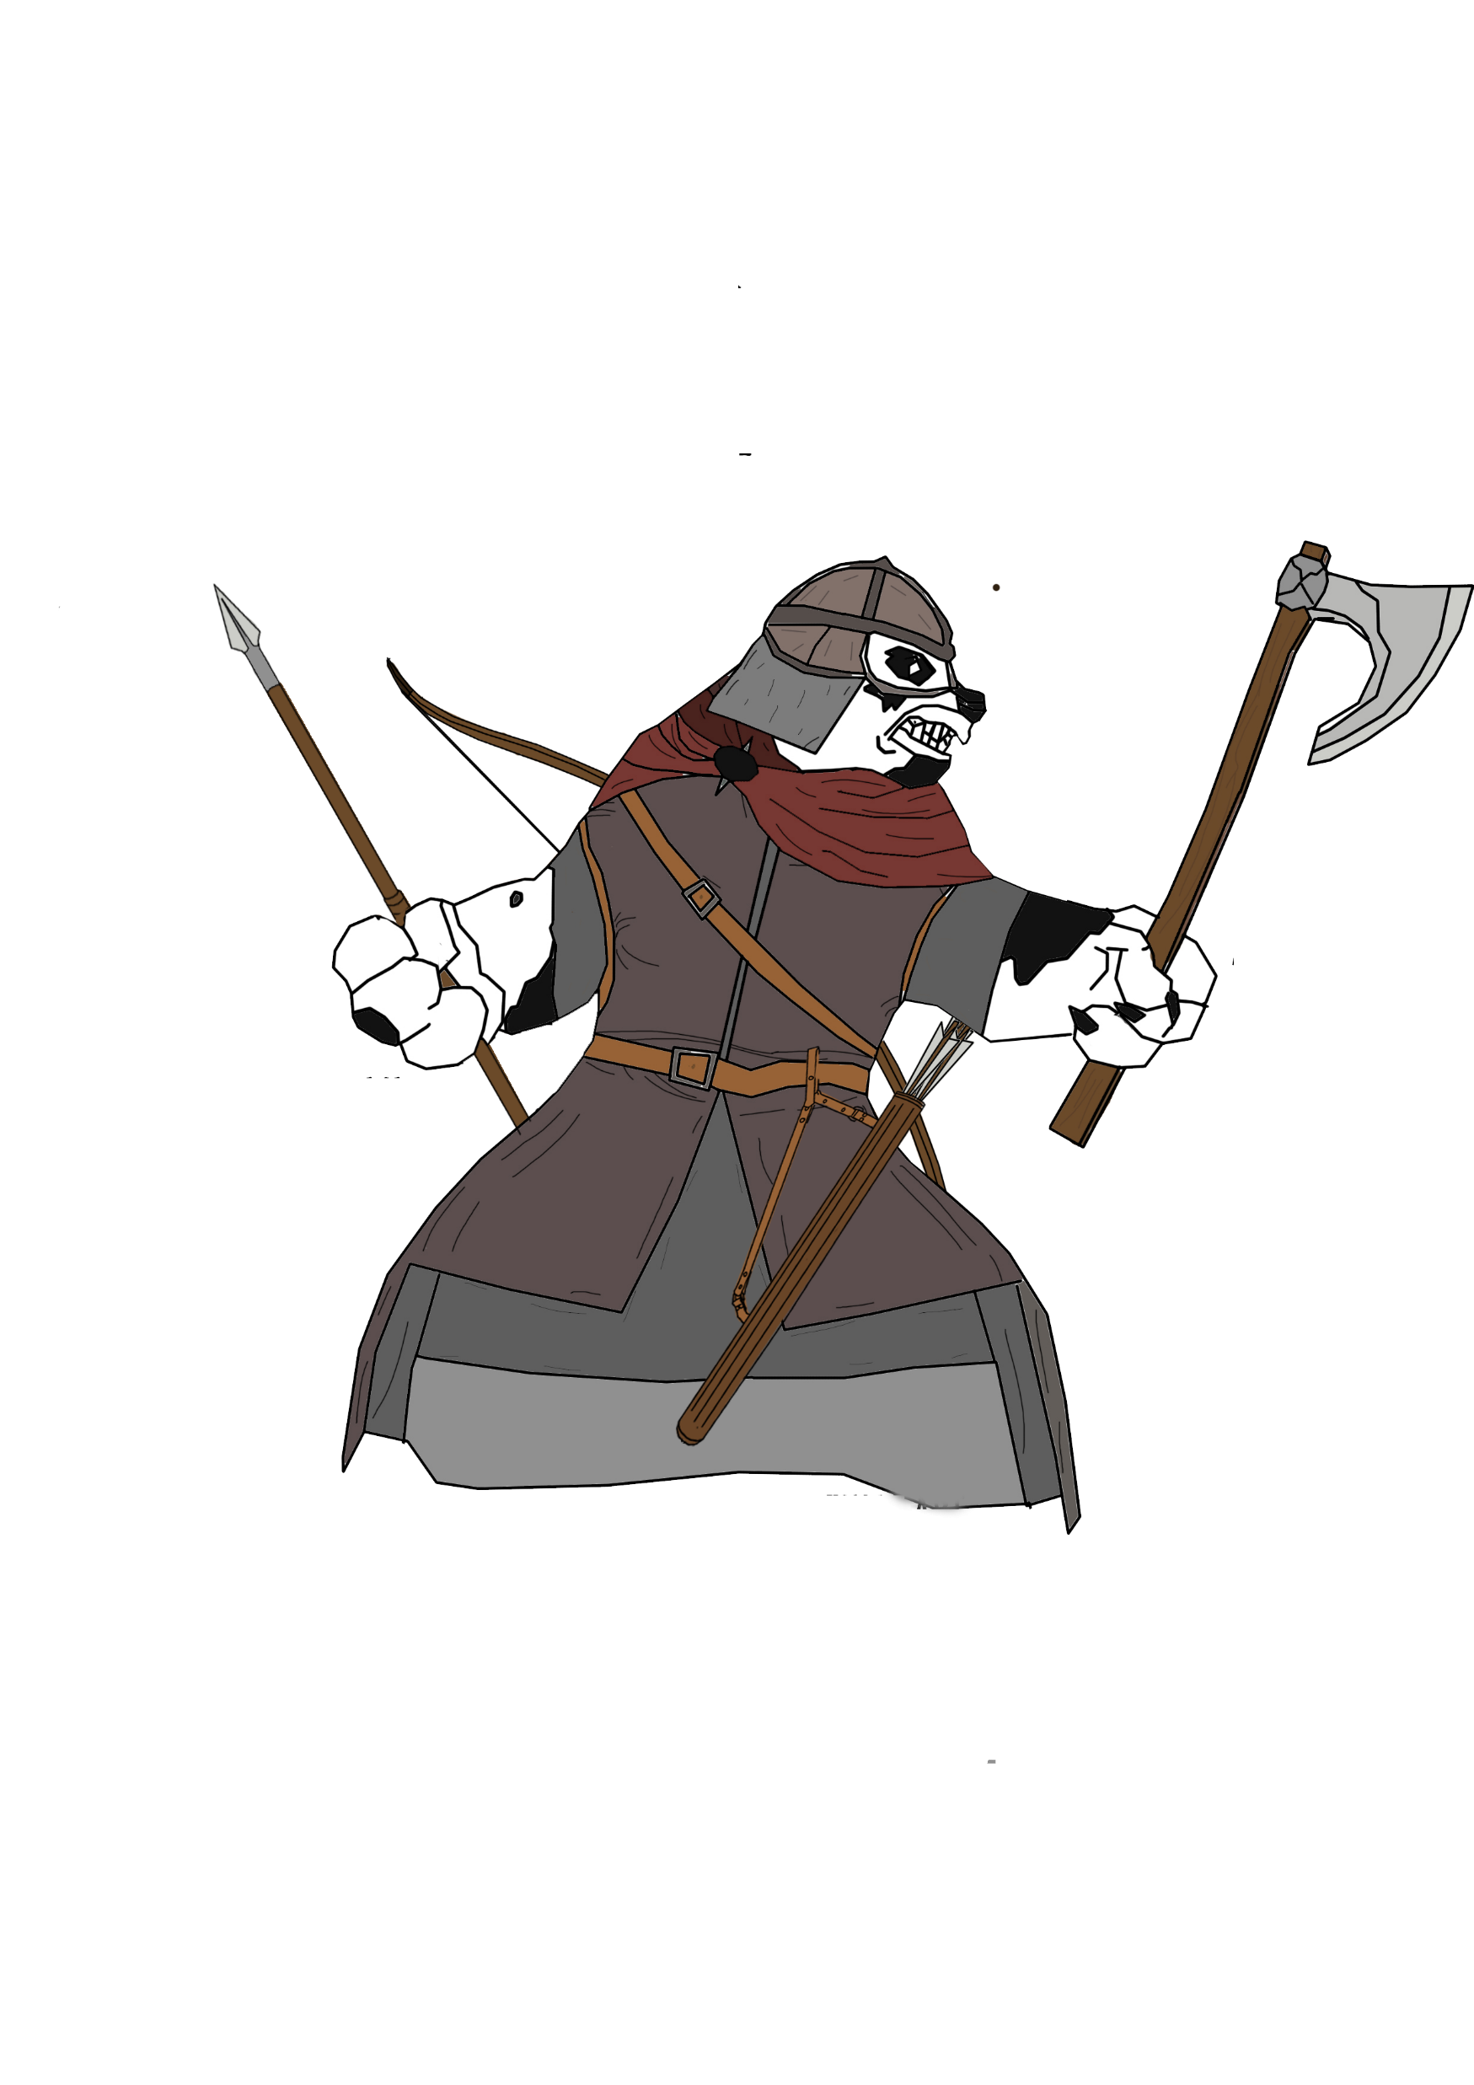
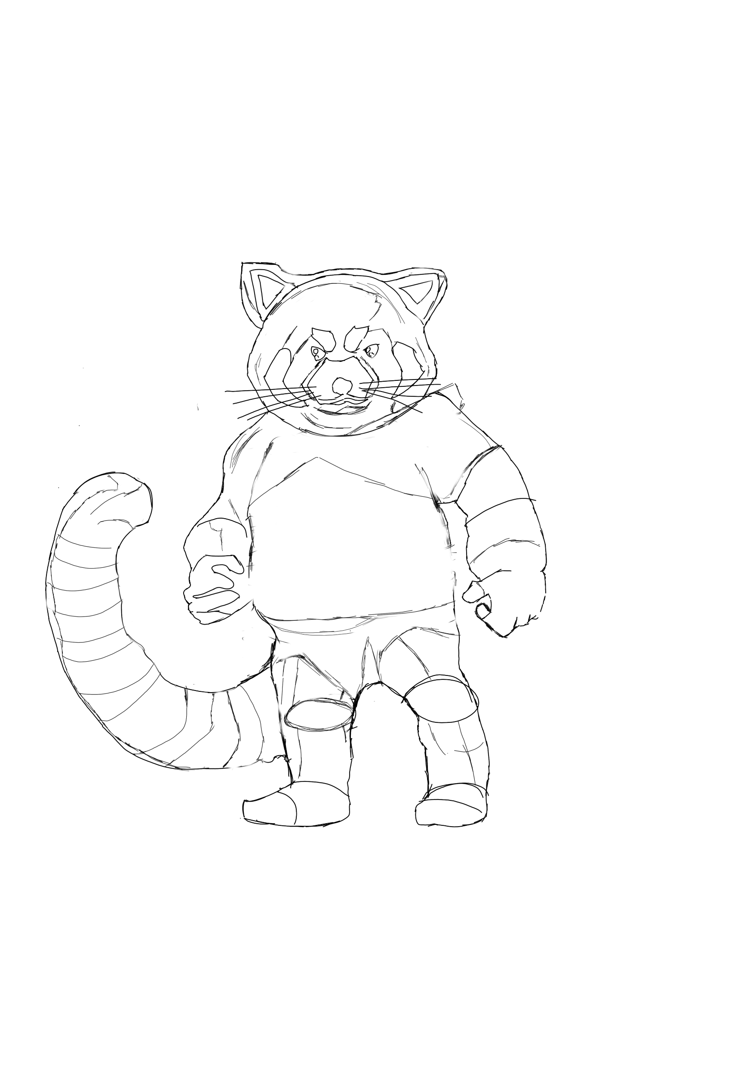
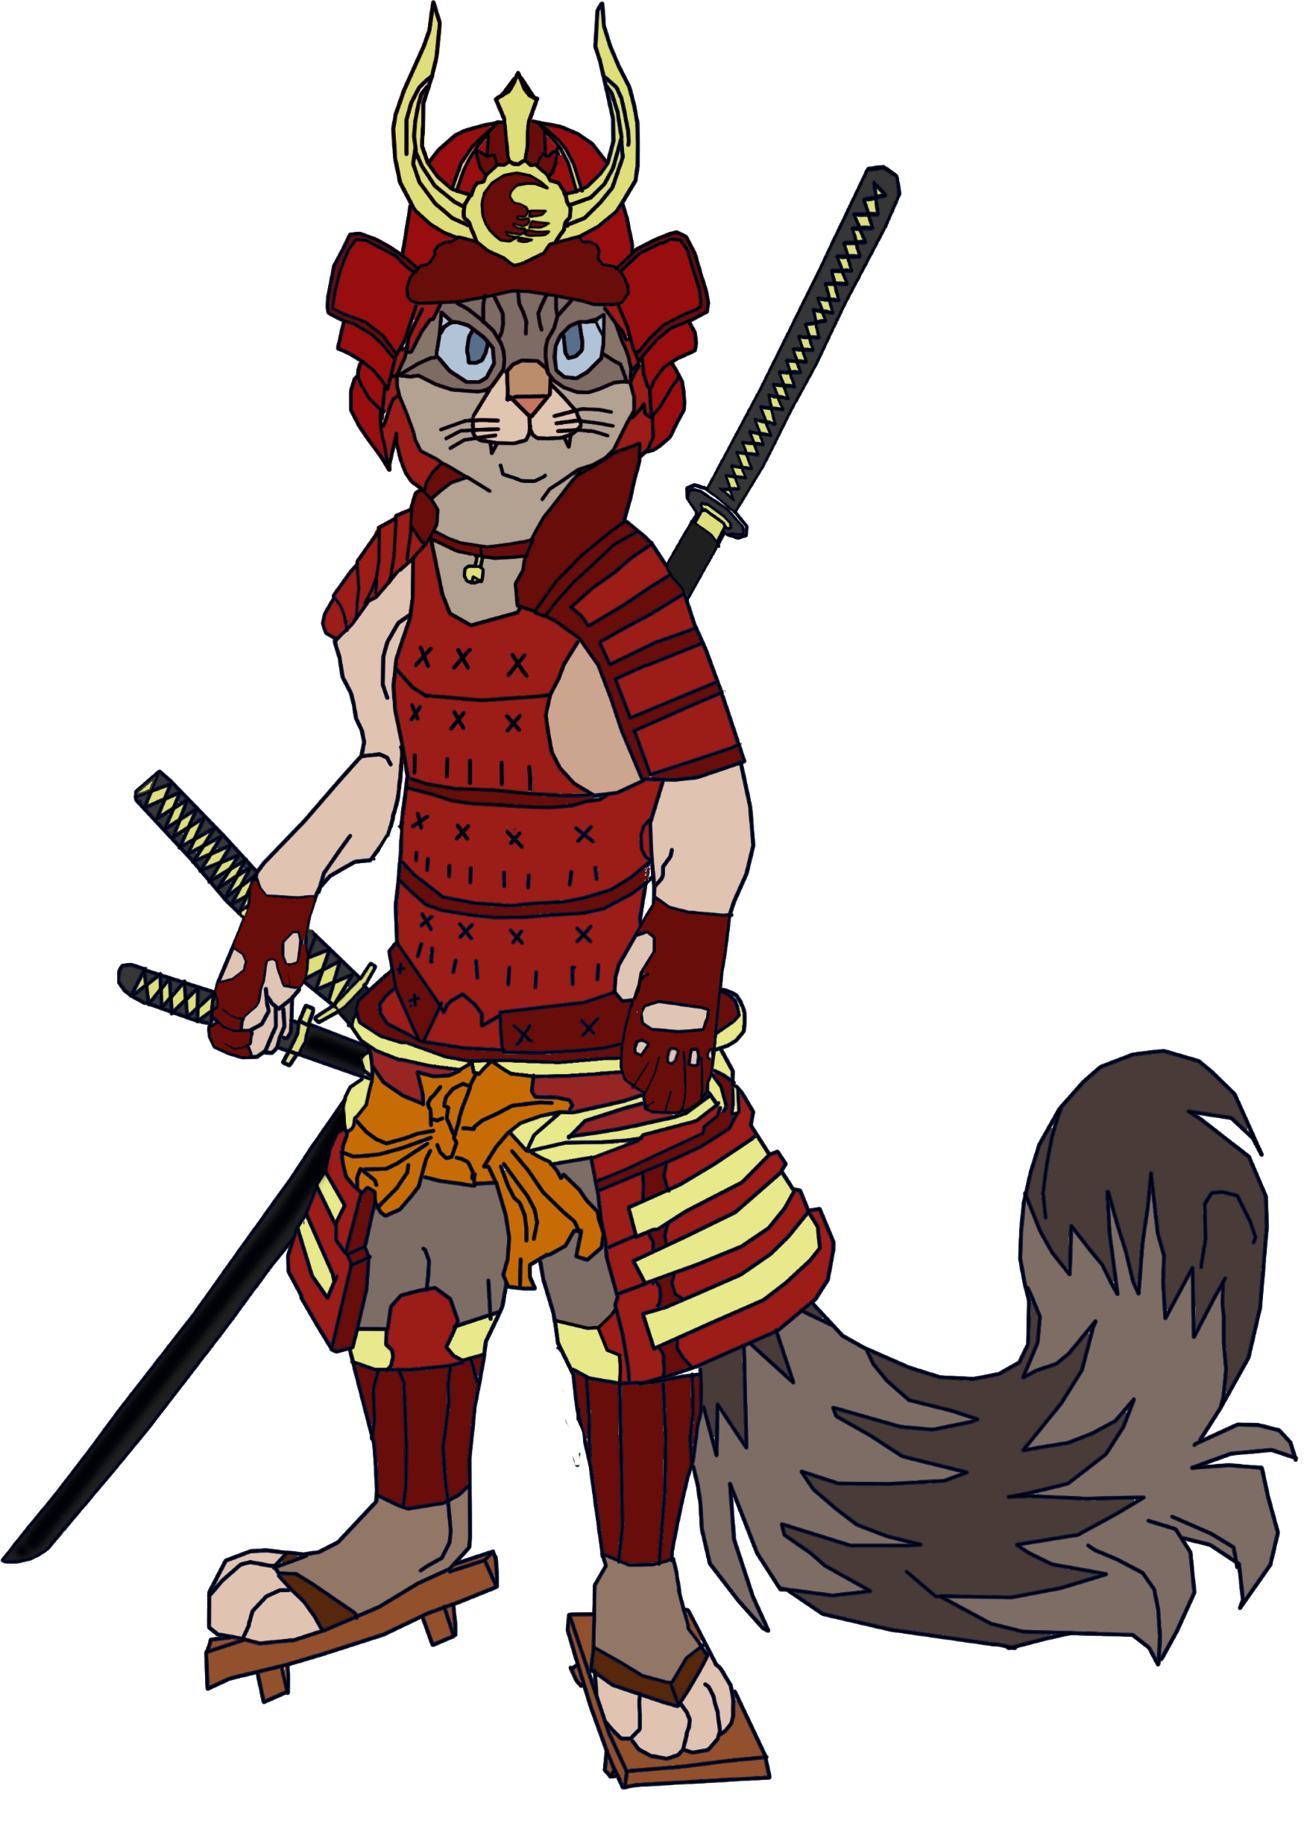
Players do not fight!
They compete in a show of skill to impress the judge
This unfinished guy

Slide 6
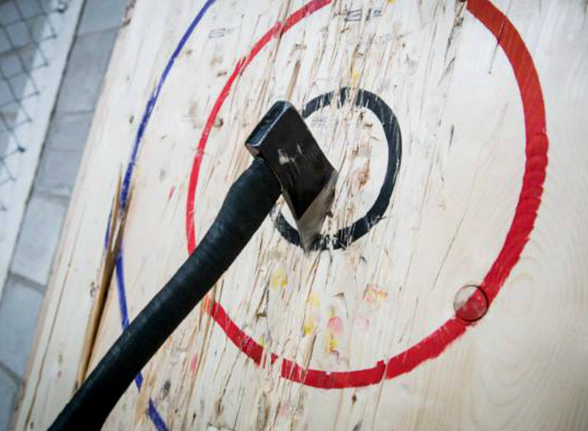
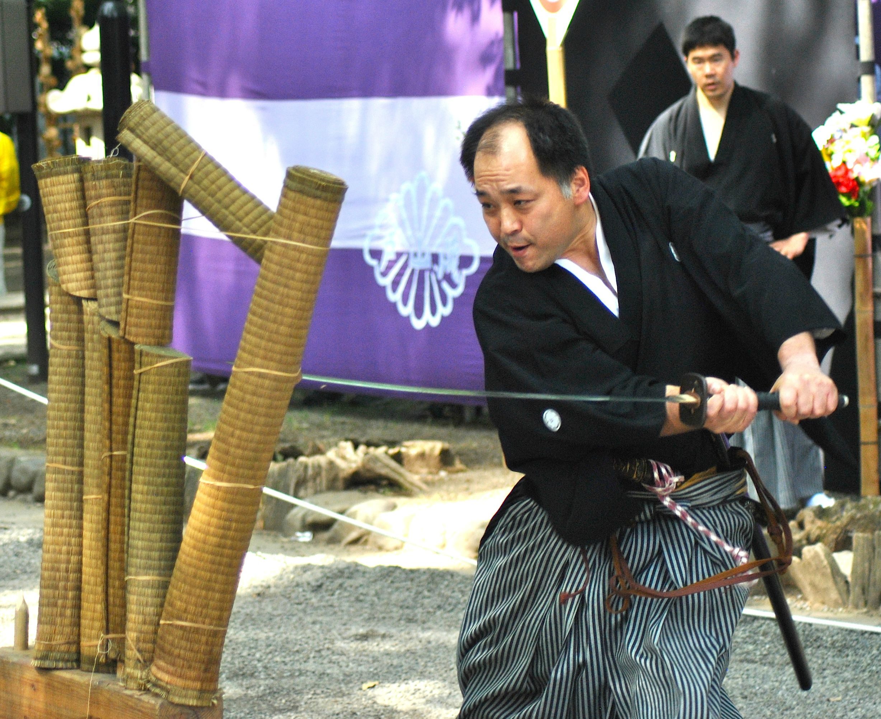
Player 1 Skill Player 2 Skill
NO MECHANICAL DIFFERENCE!

Slide 7
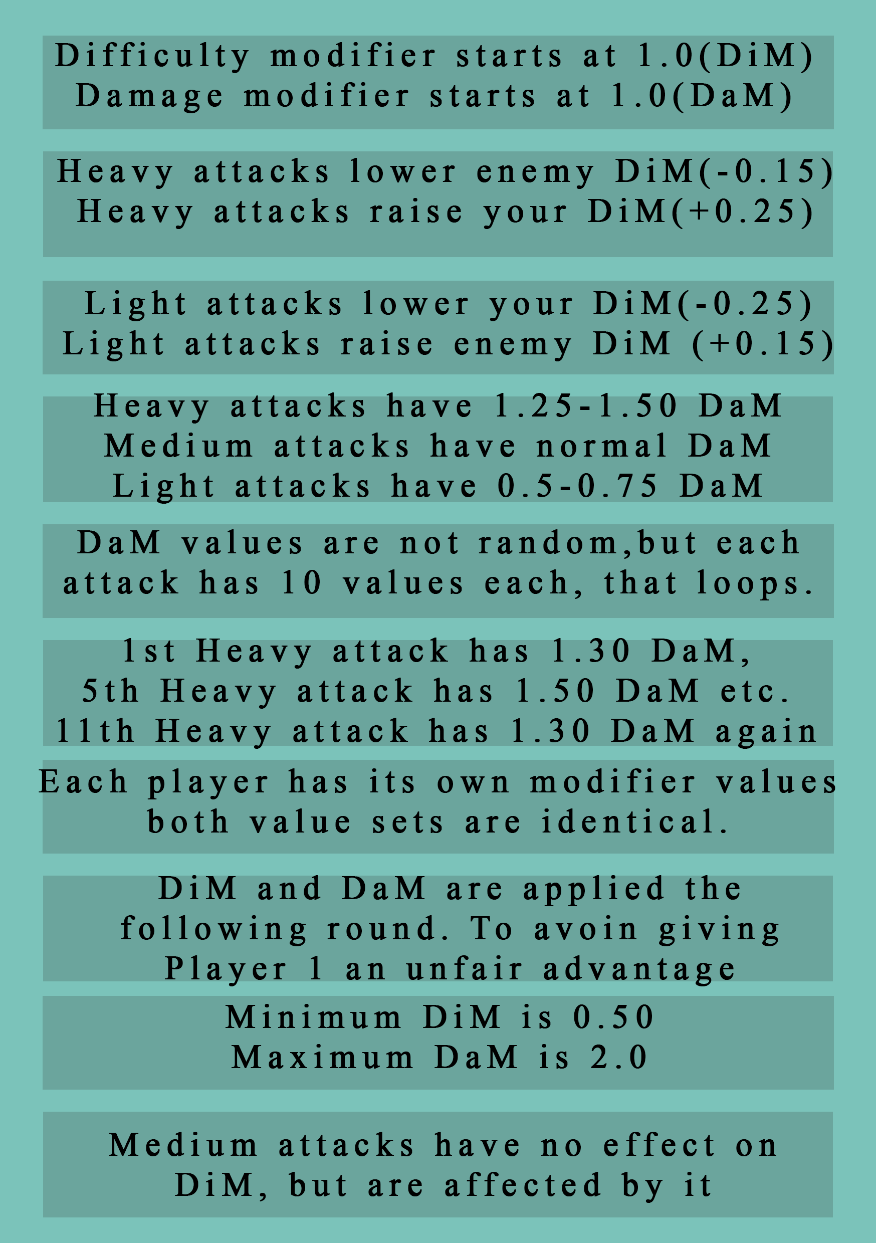
Meaningful choice:
Each type of attack has consequences
Can be easily explained to the player in a diegetic manner “Easy tricks don’t impress the judge” “You have to do even better to impress him with that again”

Slide 8
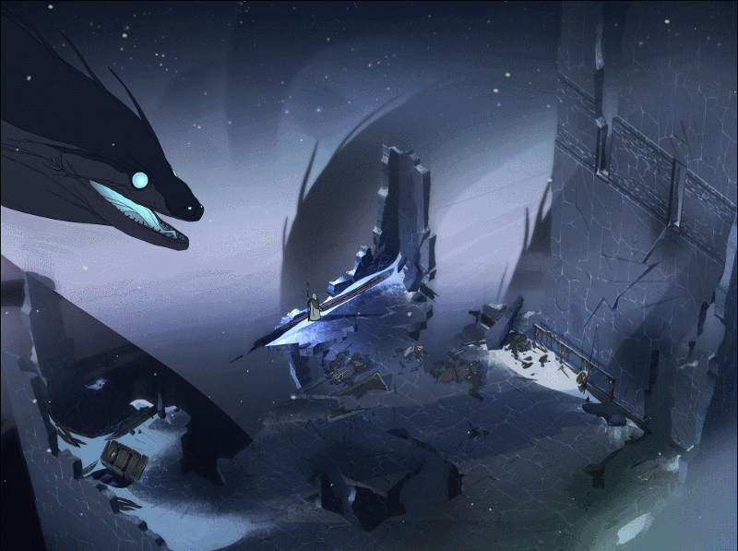
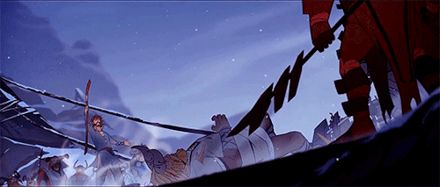
Fiero & Schadenfreude remain, empathy abandoned
Was supposed to create emphatic responses, by pitting the players against each other .
Each player would have a small fighting band and a caravan of sick & weak behind them.
Camera would pan to show each player: His caravan, his warband, enemy warband, danger, escape!
The players would fight to save their people from the danger (only 1 caravan can escape)

Slide 9
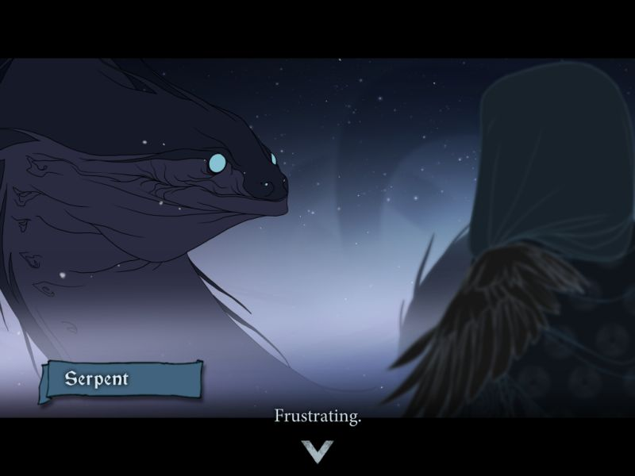
Empathy idea abandoned due to it being too much of a challenge for a solo project

Slide 10
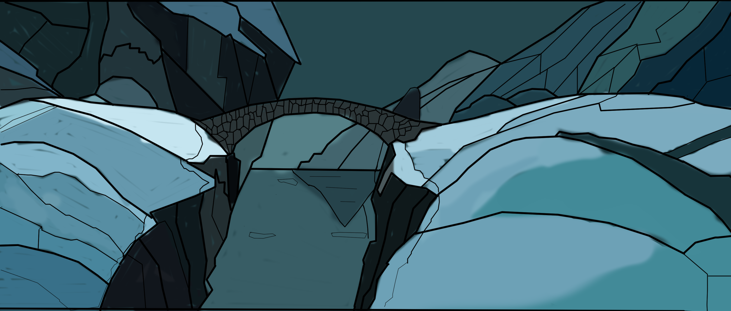
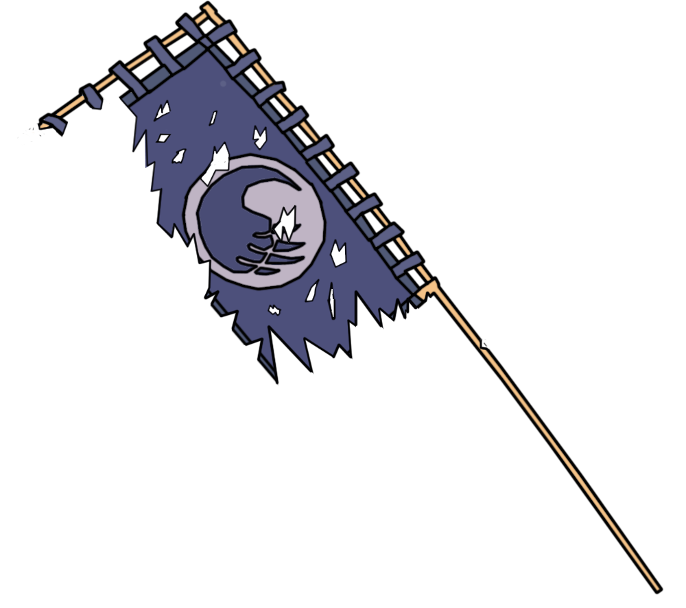

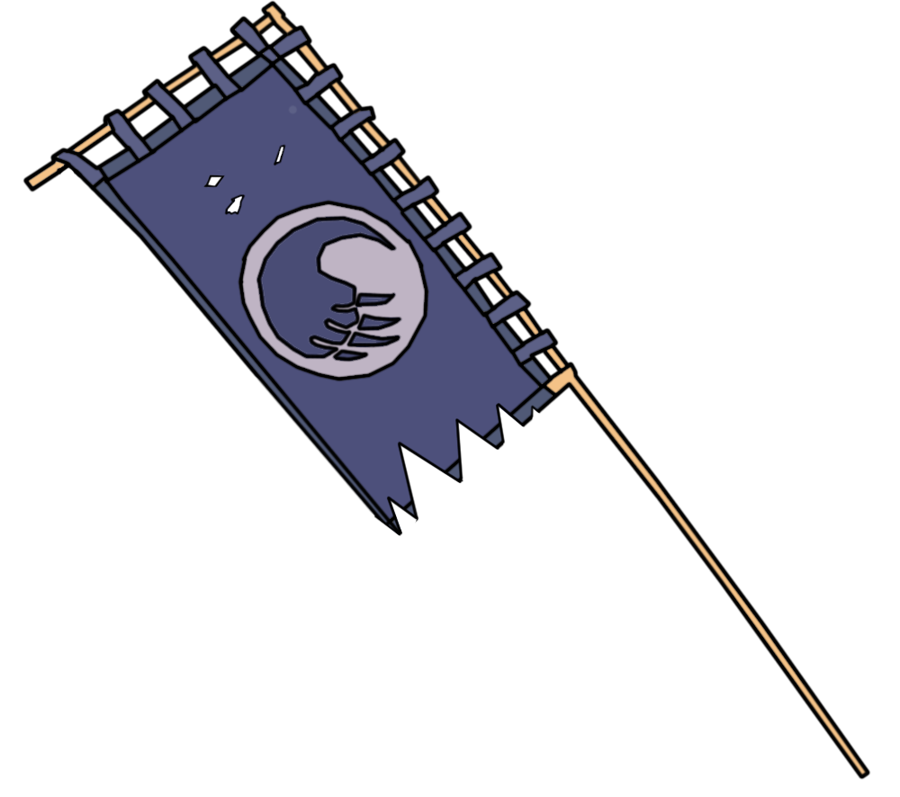

Aestetics:

Slide 11
I take full responsibility of the project’s current state and highly probably failure. If I make any excuses please slap me!
ROAST ME!

